Slide 1

RUNGTA COLLEGE OF DENTAL SCIENCES & RESEARCH
MINOR SURGICAL PROCEDURES
DEPARTMENT OF PEDODONTICS AND PREVENTIVE DENTISTRY

Slide 2
SPECIFIC LEARNING OBJECTIVES
Core areas | Domain
Introduction Indications of extraction Contraindication of extraction Principles of extraction | Operative complications Postoperative care

Slide 3
CATEGORY
MUST TO KNOW
NICE TO KNOW
Incisional biopsy
DESIRE TO KNOW
Marsupilization
Extraction
Incision and flap
Incision and drainage
Excisional biopsy
Enucleation

Slide 4
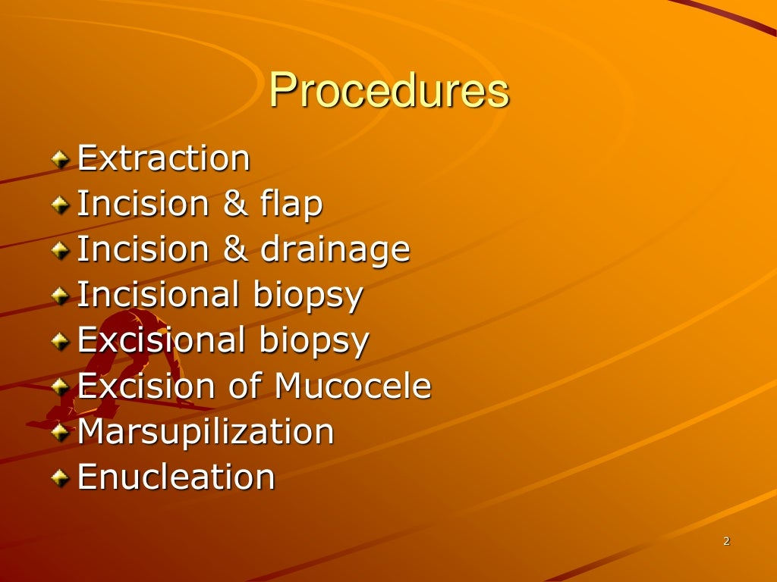

Slide 5
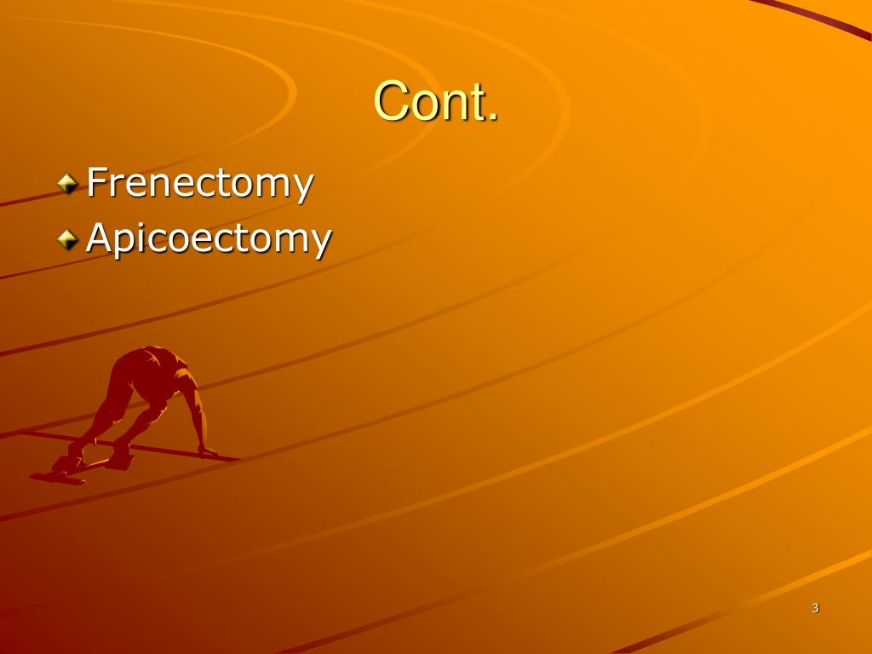

Slide 6
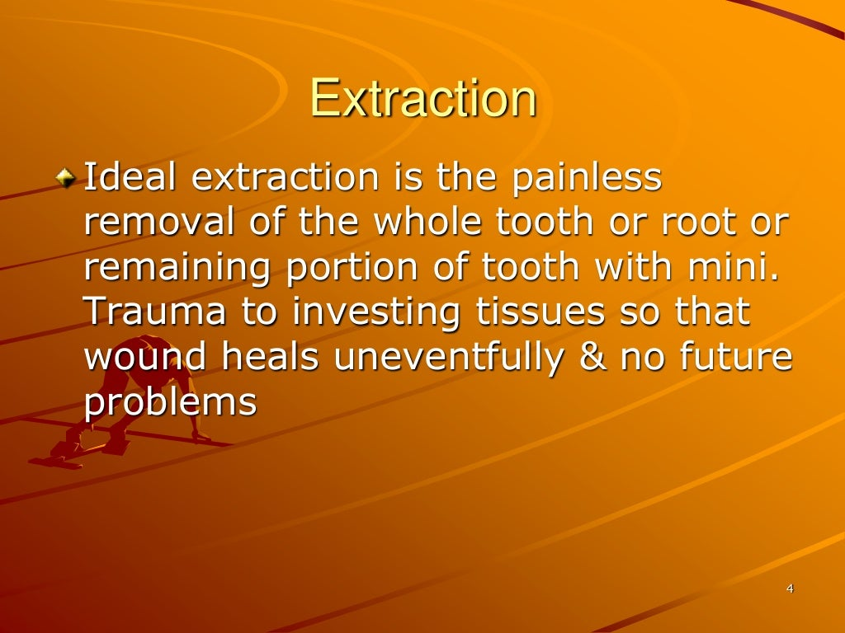

Slide 7
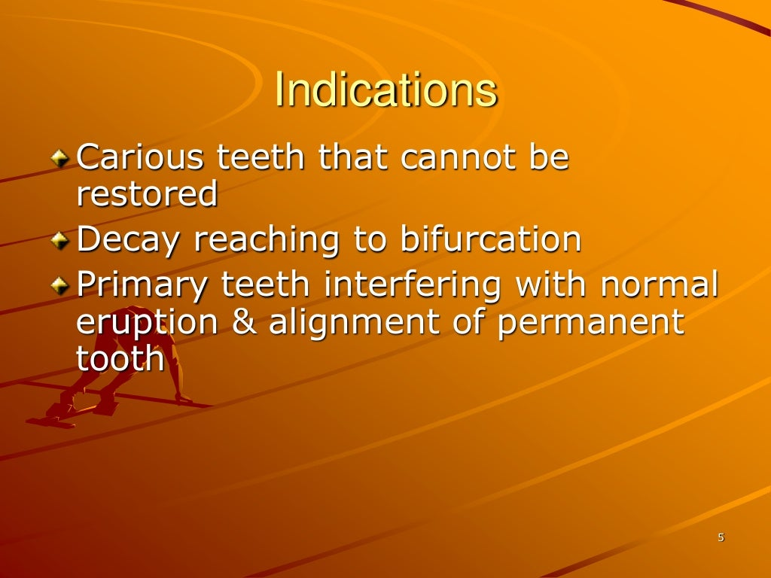

Slide 8
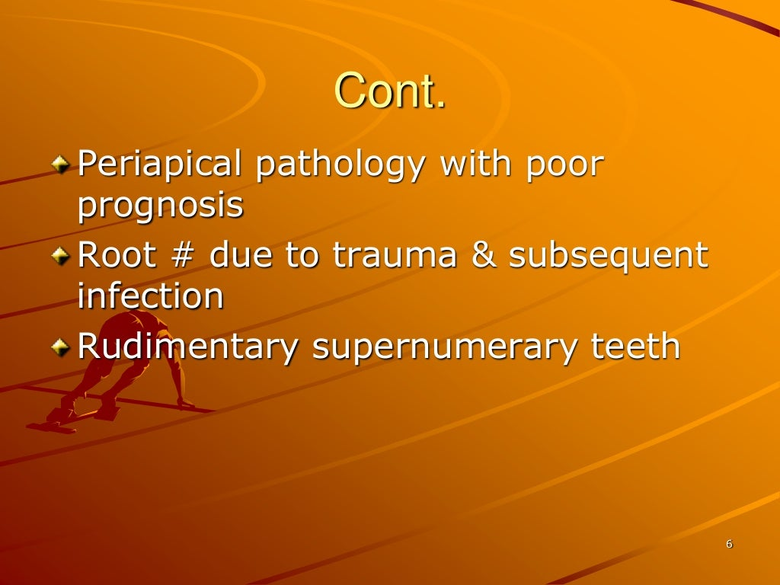

Slide 9
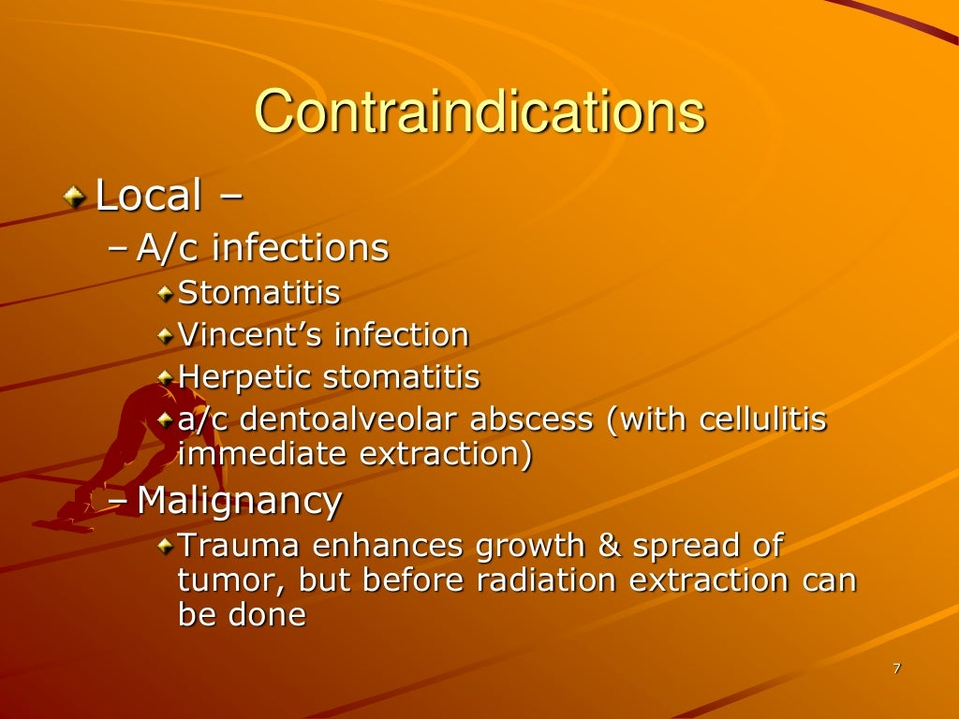

Slide 10
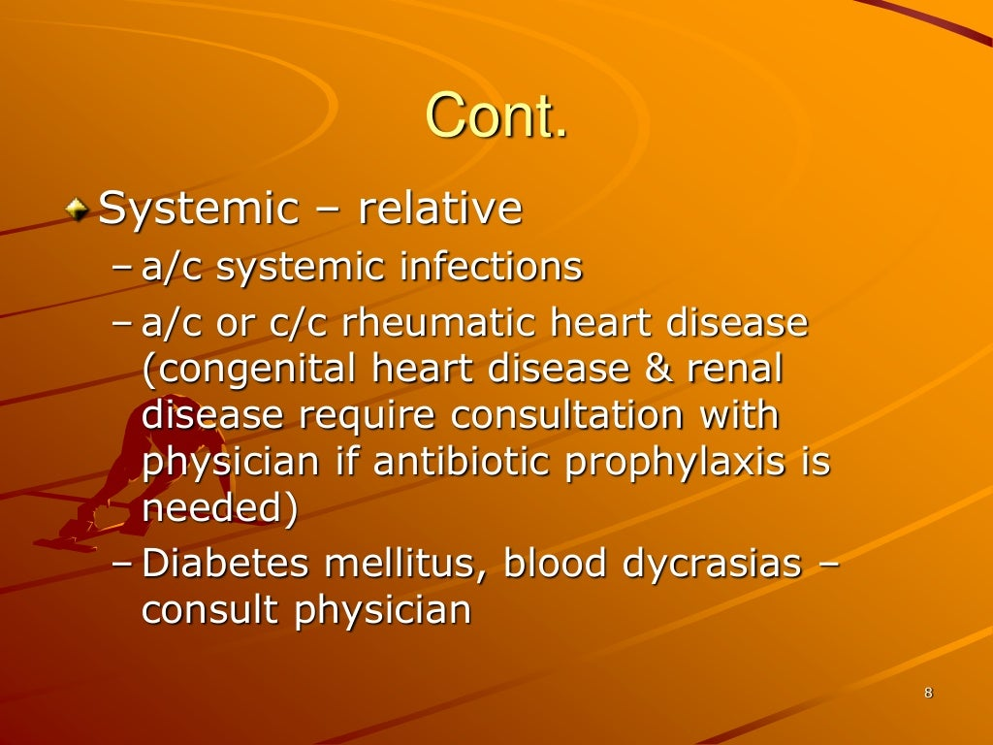

Slide 11
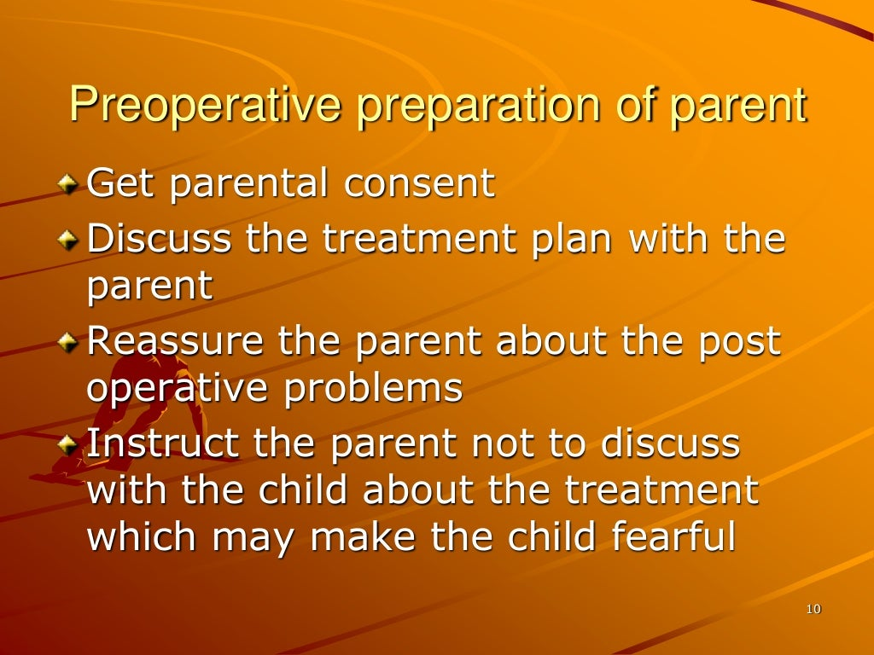

Slide 12
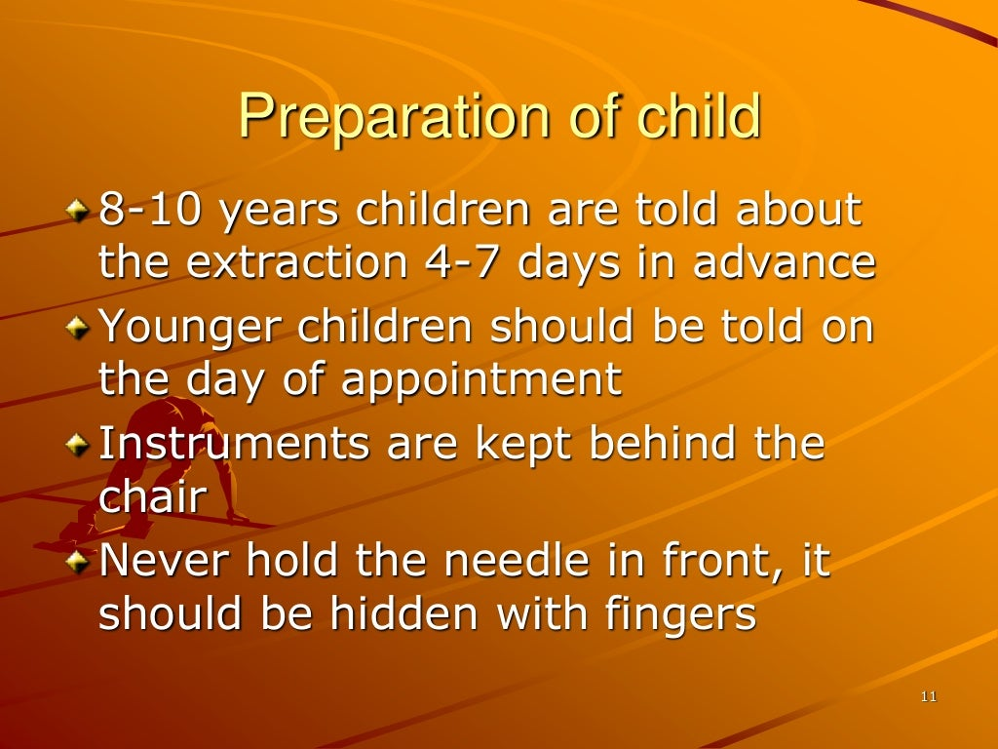

Slide 13
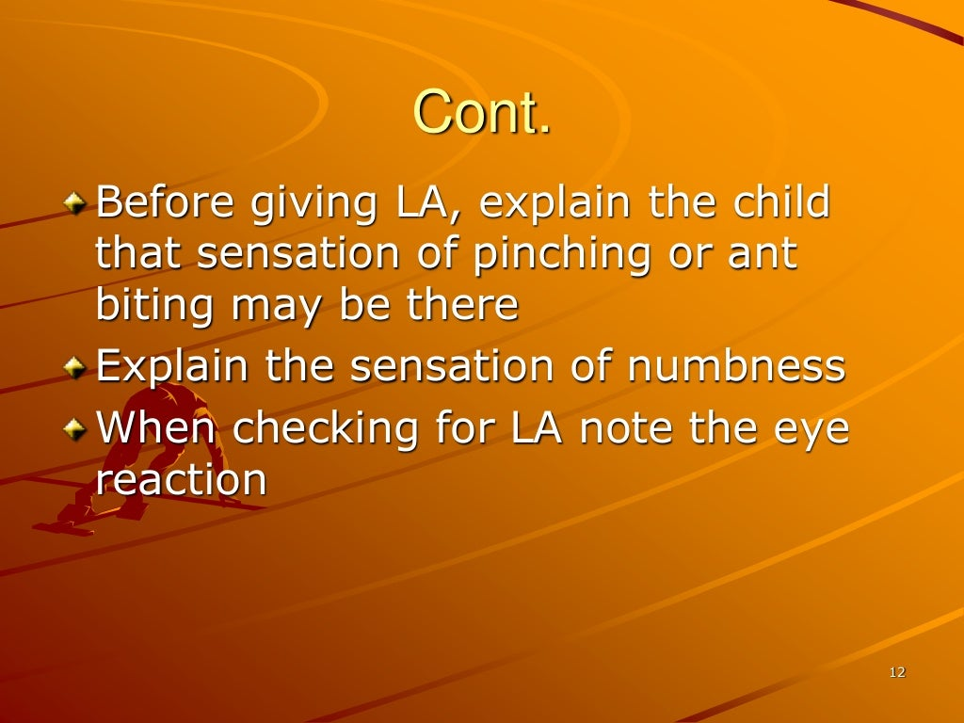

Slide 14
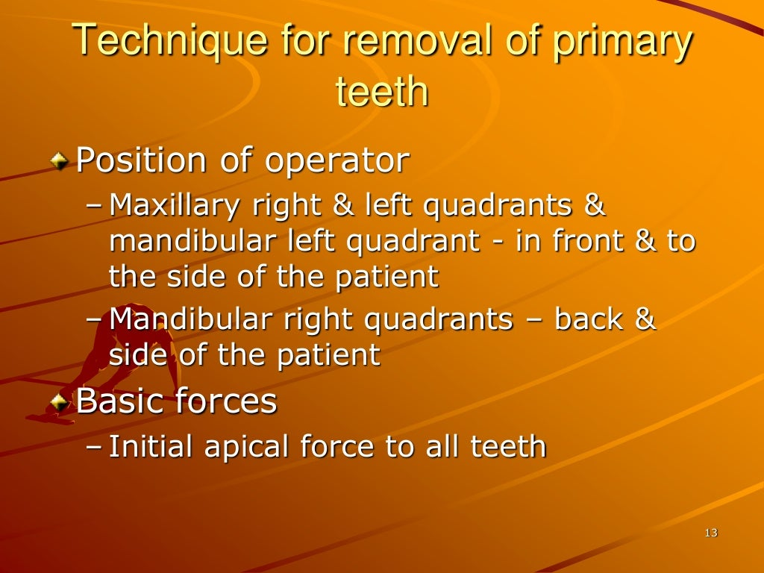

Slide 15
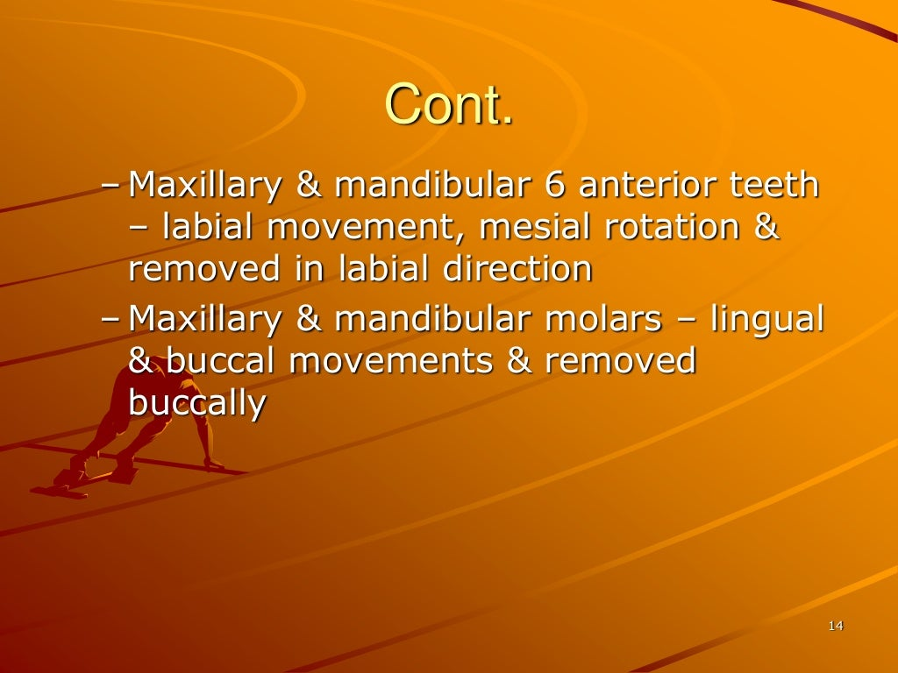

Slide 16
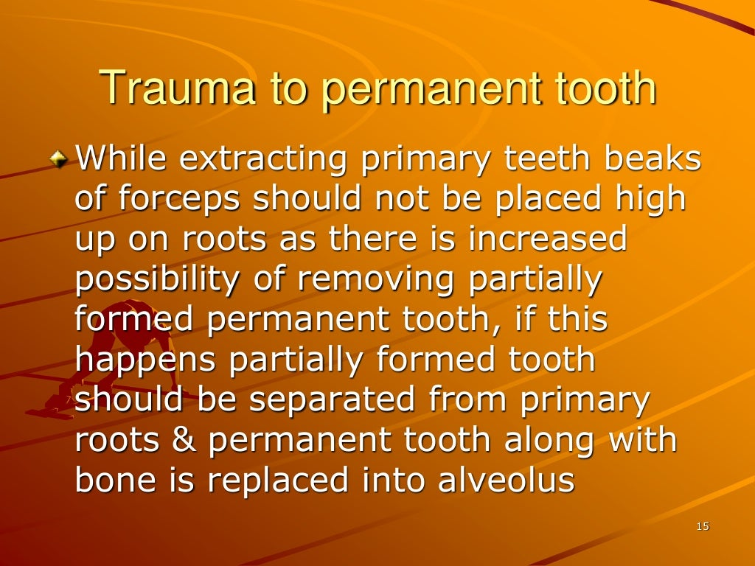

Slide 17
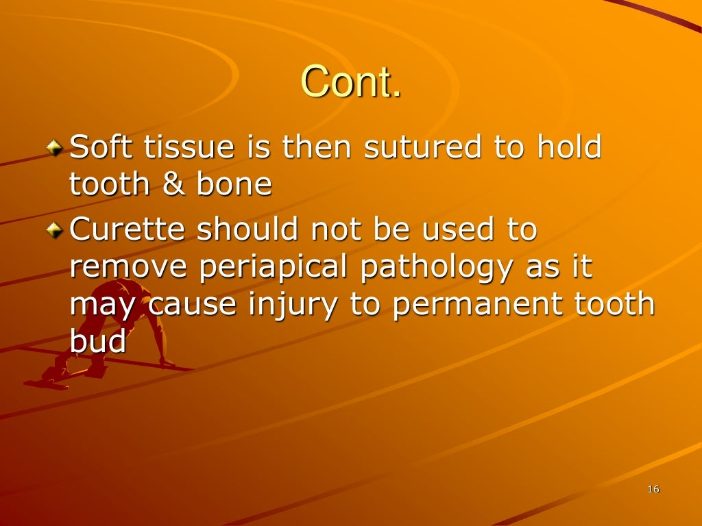

Slide 18
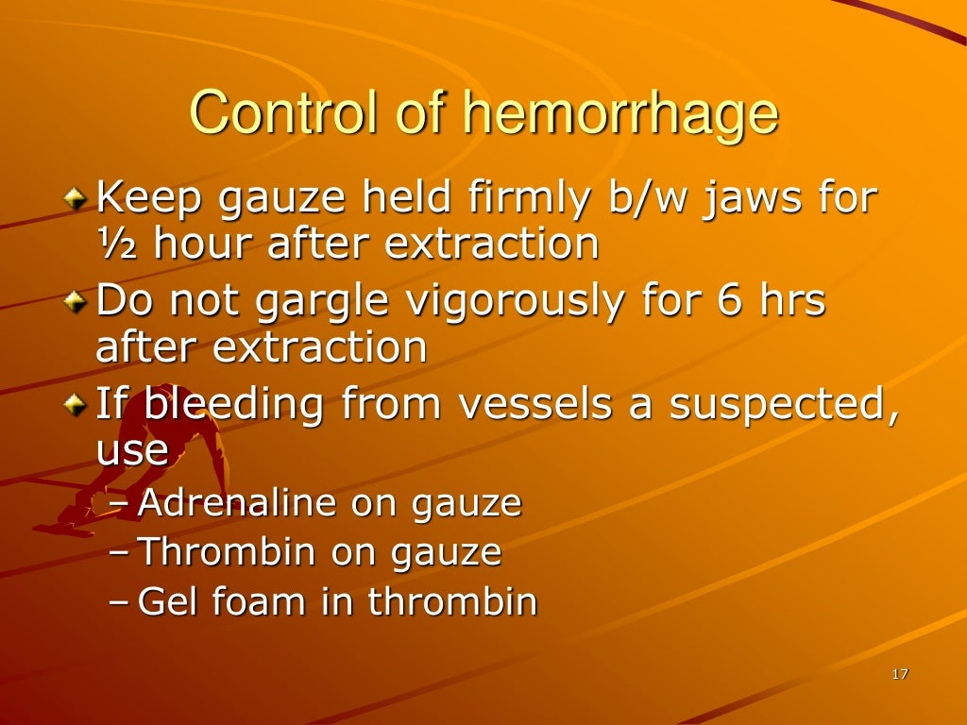

Slide 19
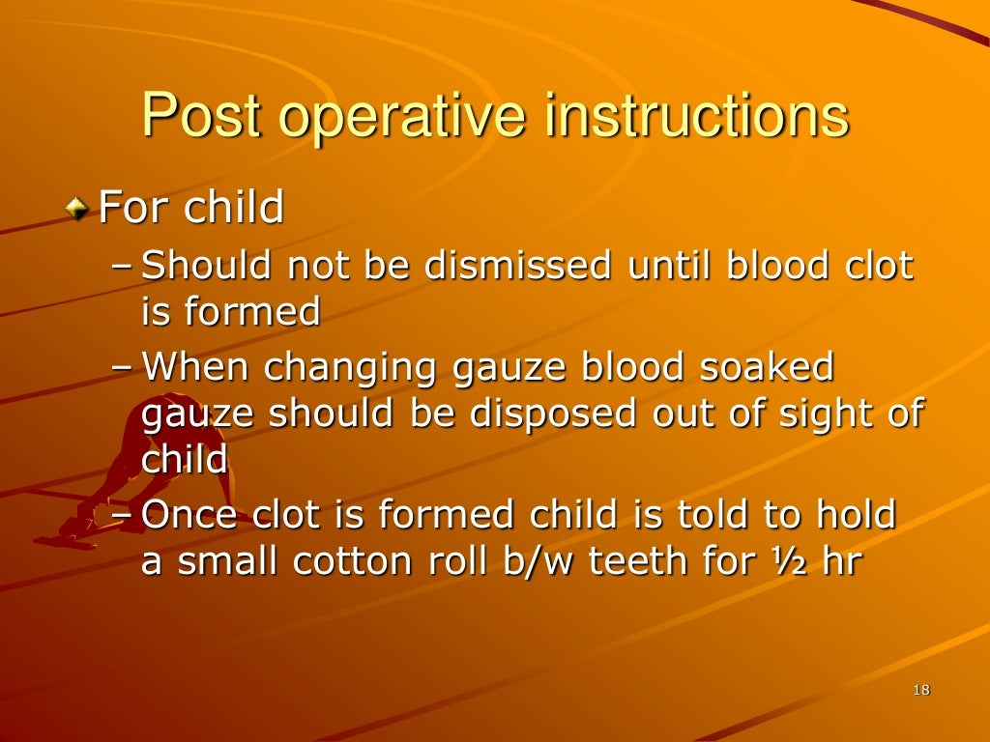

Slide 20
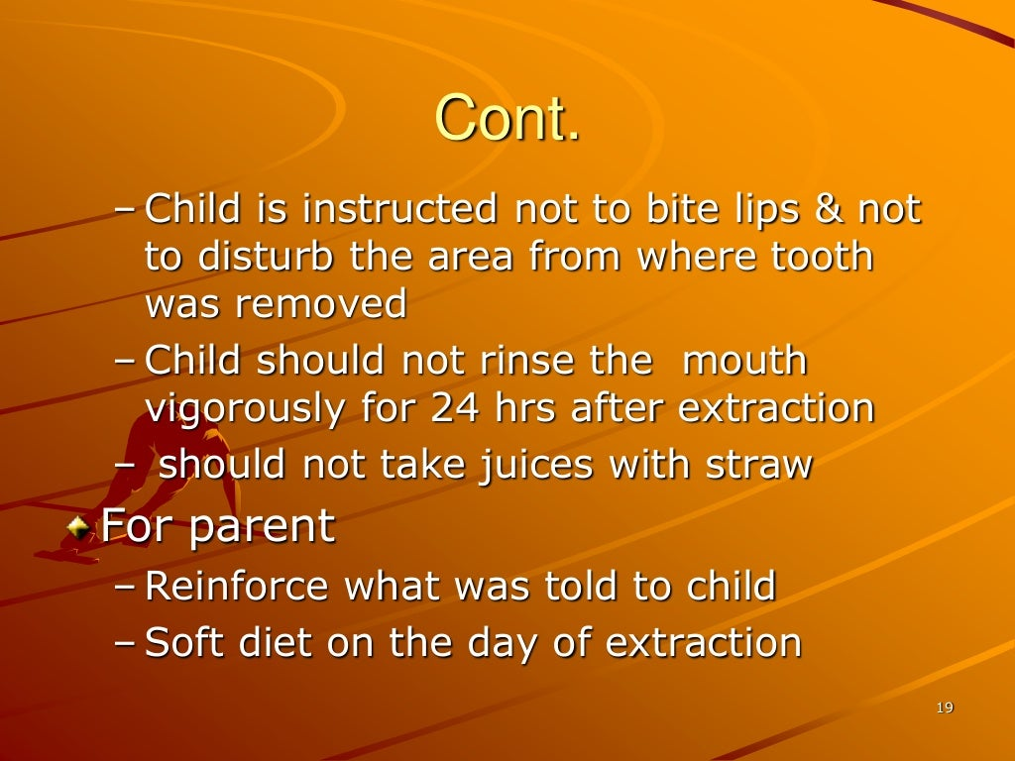

Slide 21
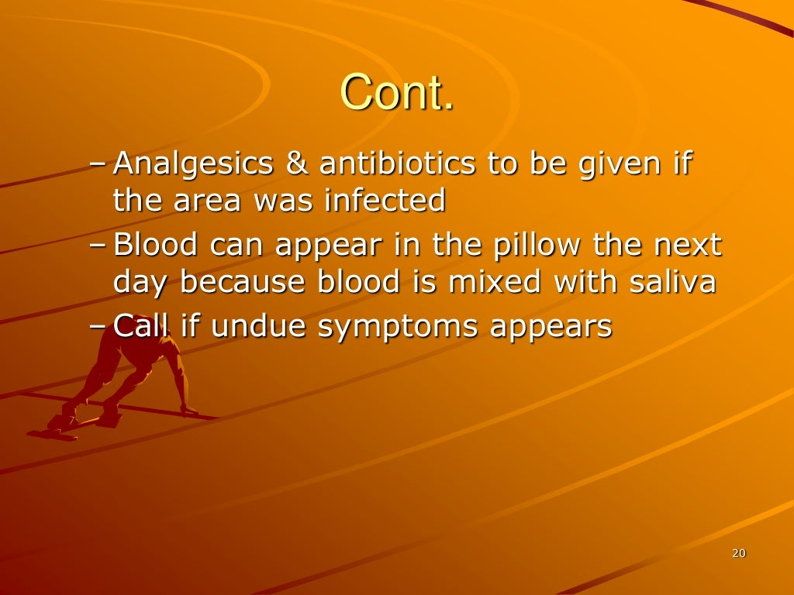

Slide 22
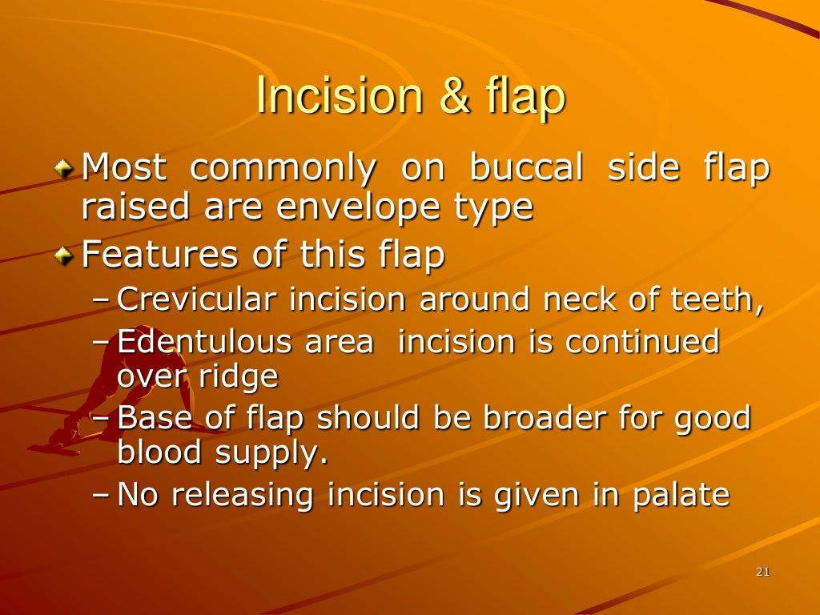

Slide 23
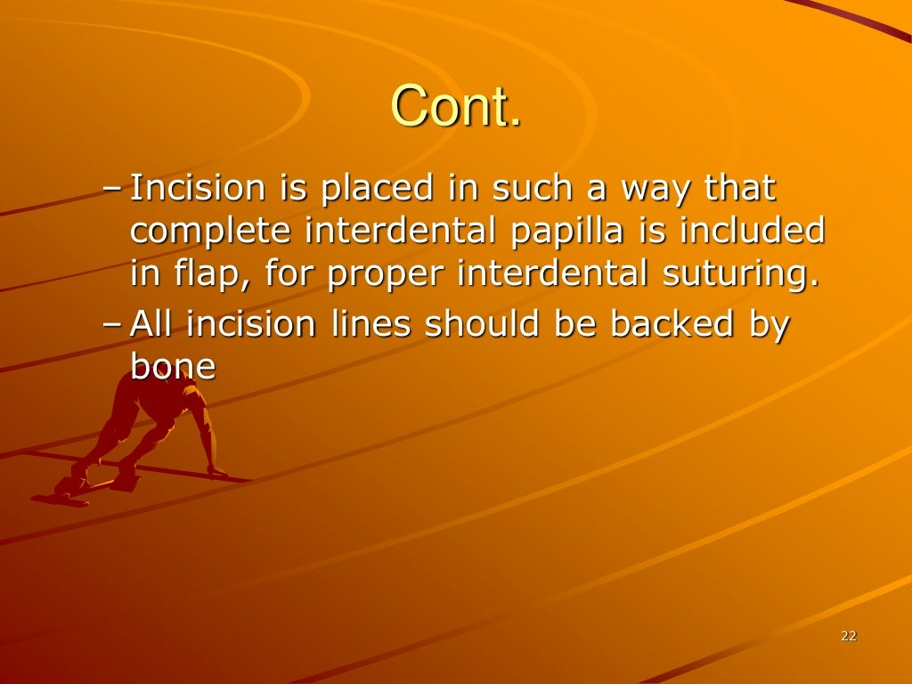

Slide 24
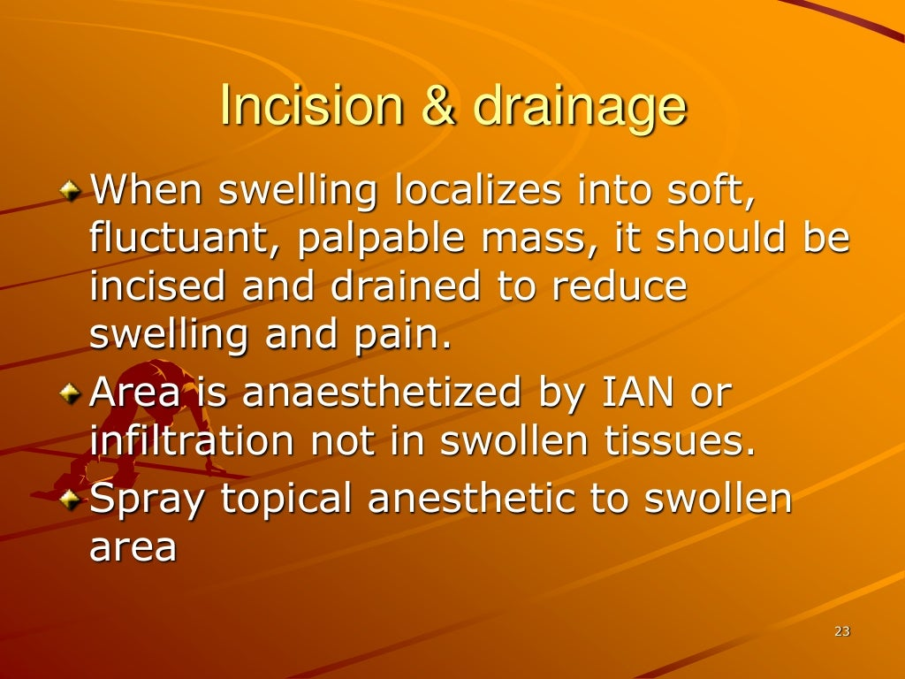

Slide 25
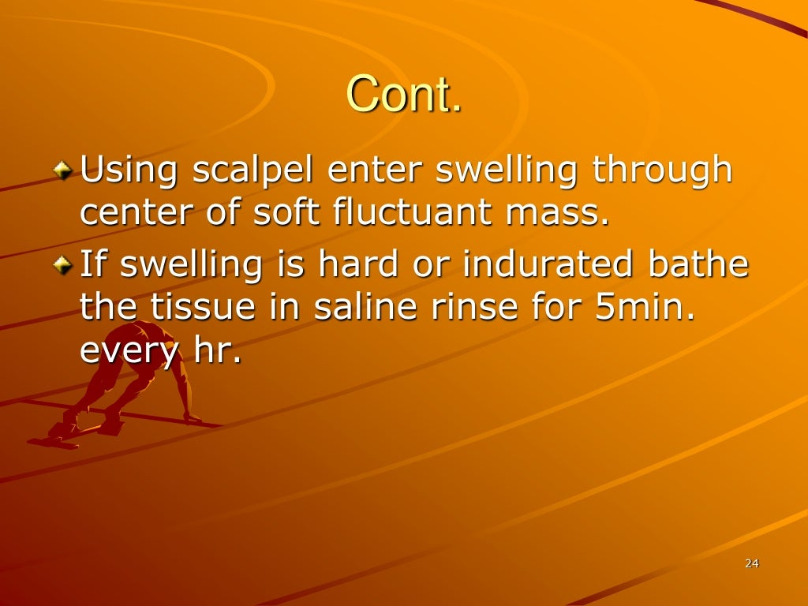

Slide 26
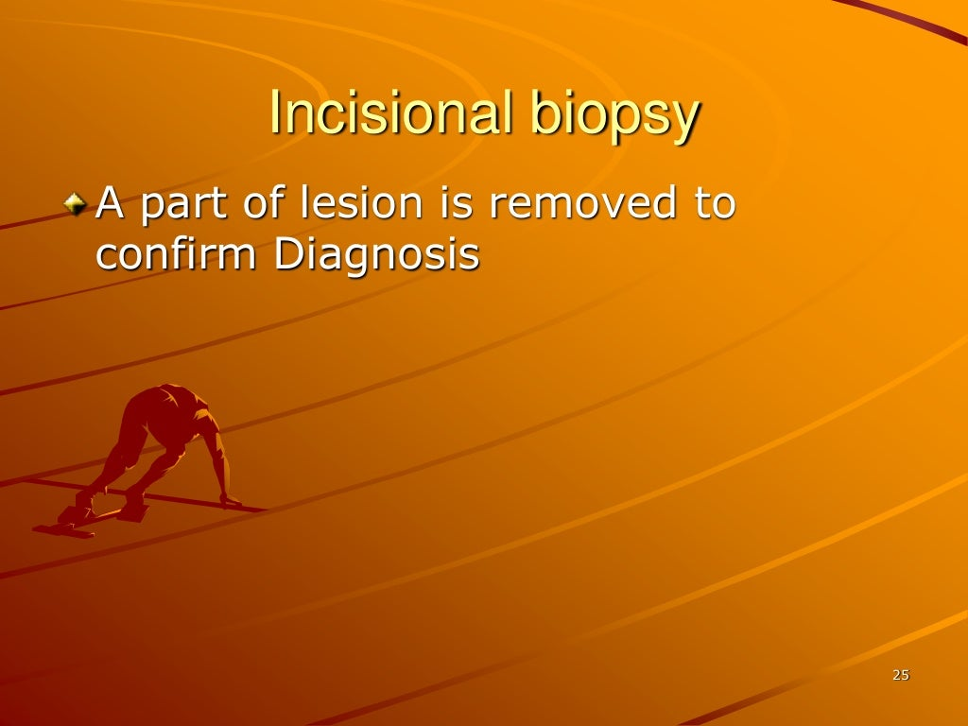

Slide 27
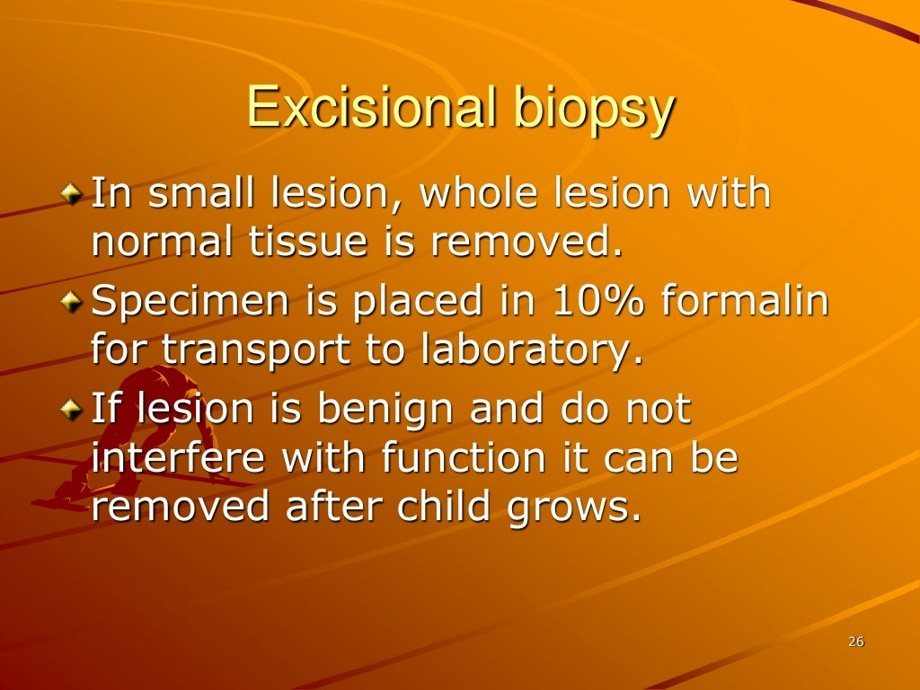

Slide 28
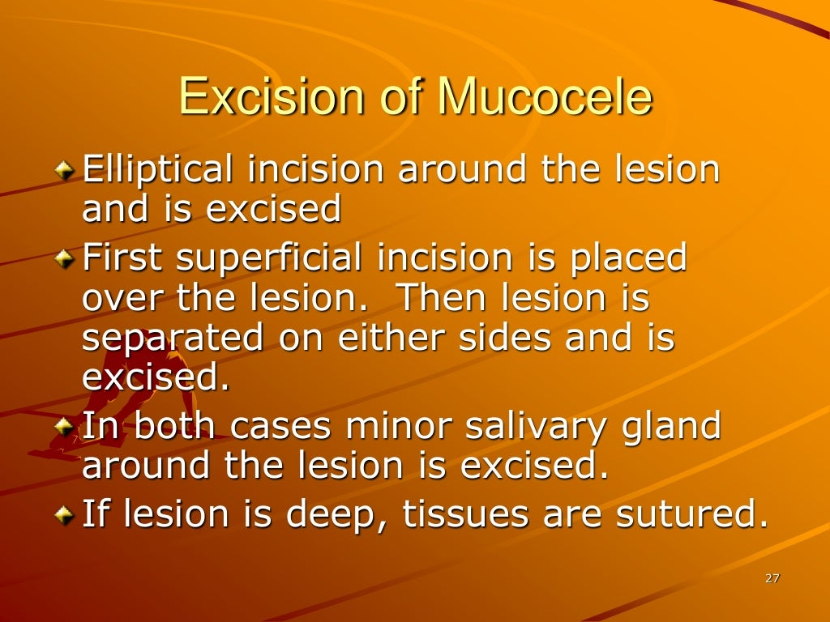

Slide 29
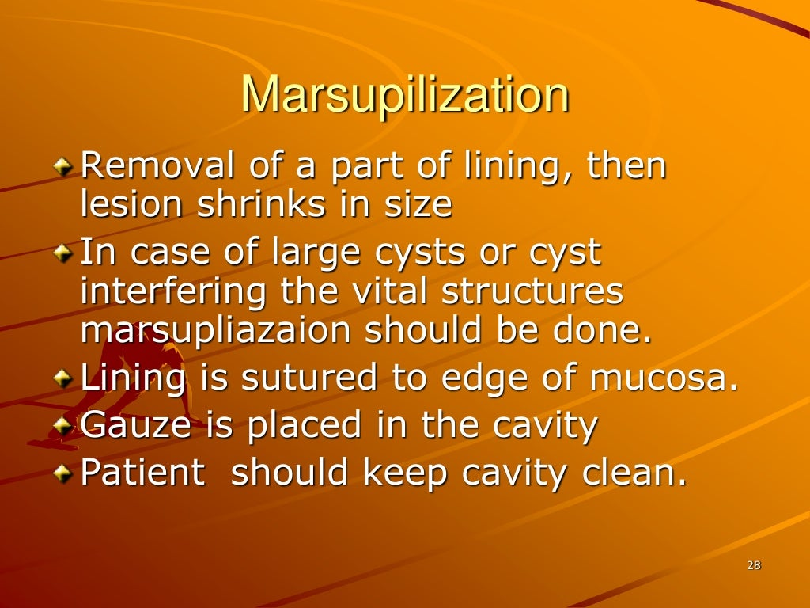

Slide 30
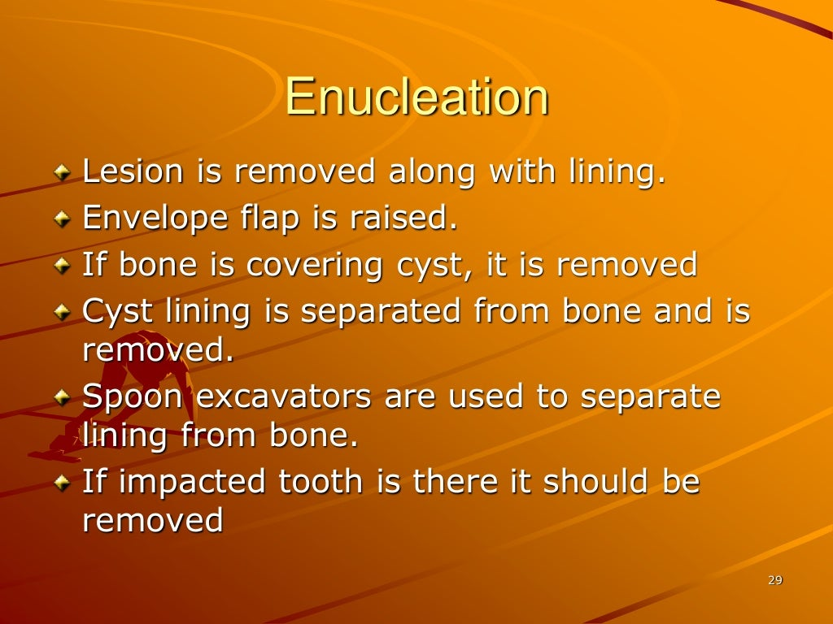

Slide 31
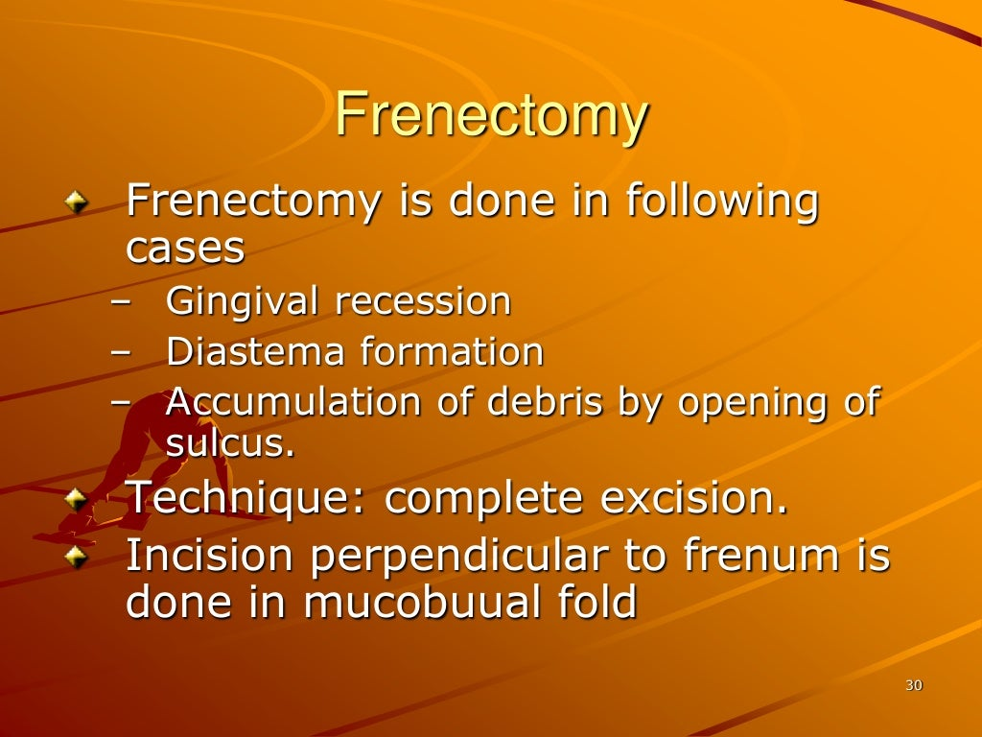

Slide 32
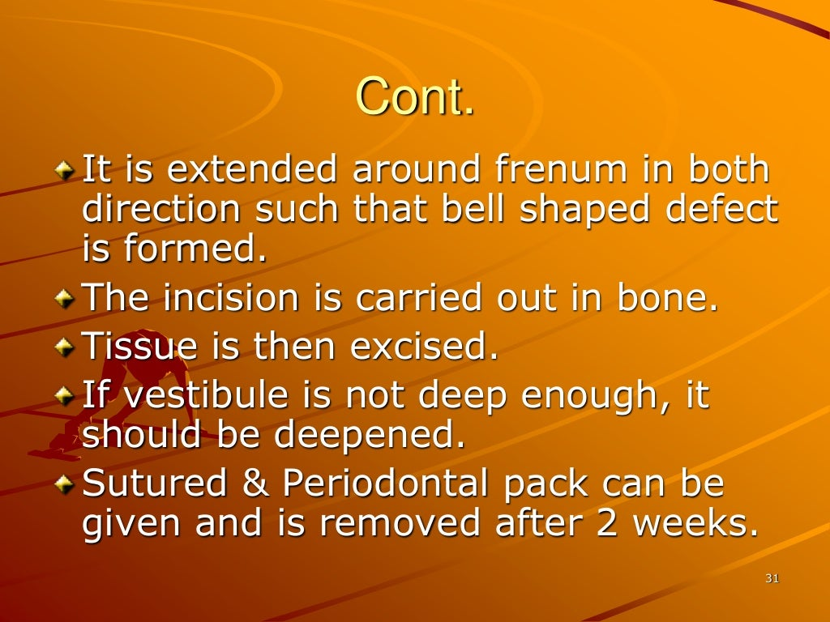

Slide 33
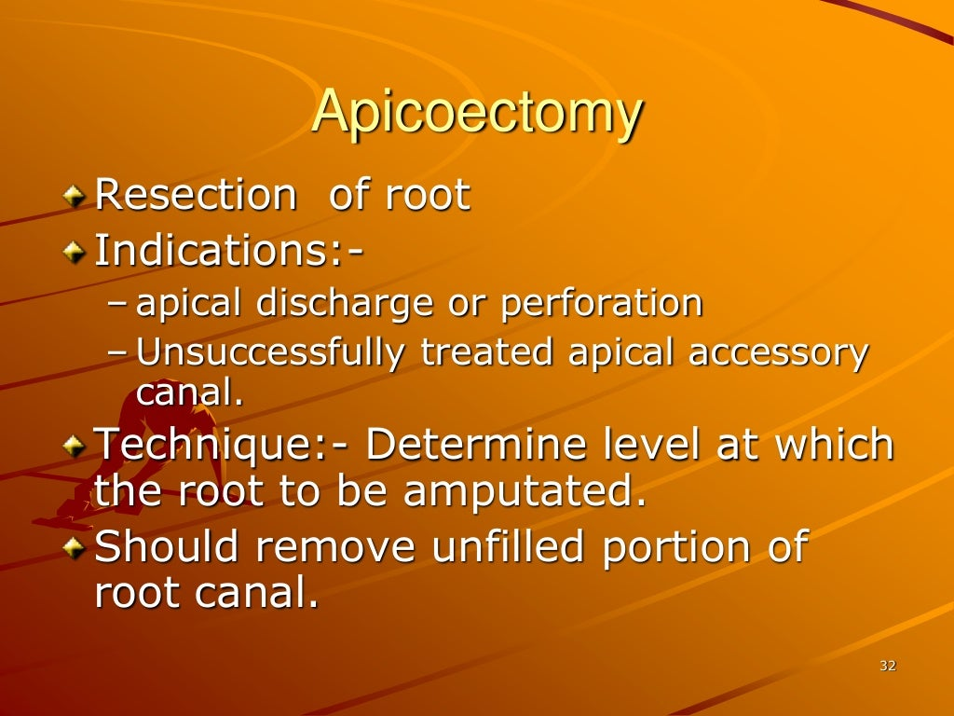

Slide 34
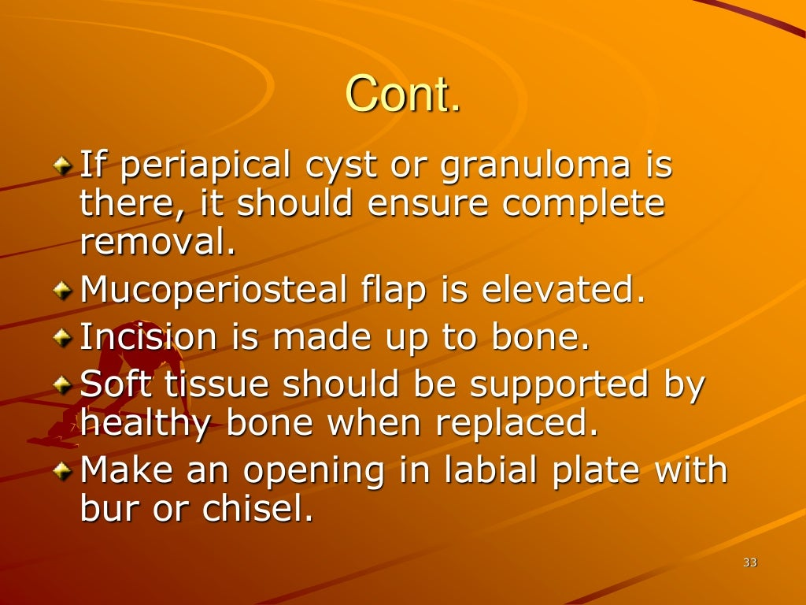

Slide 35
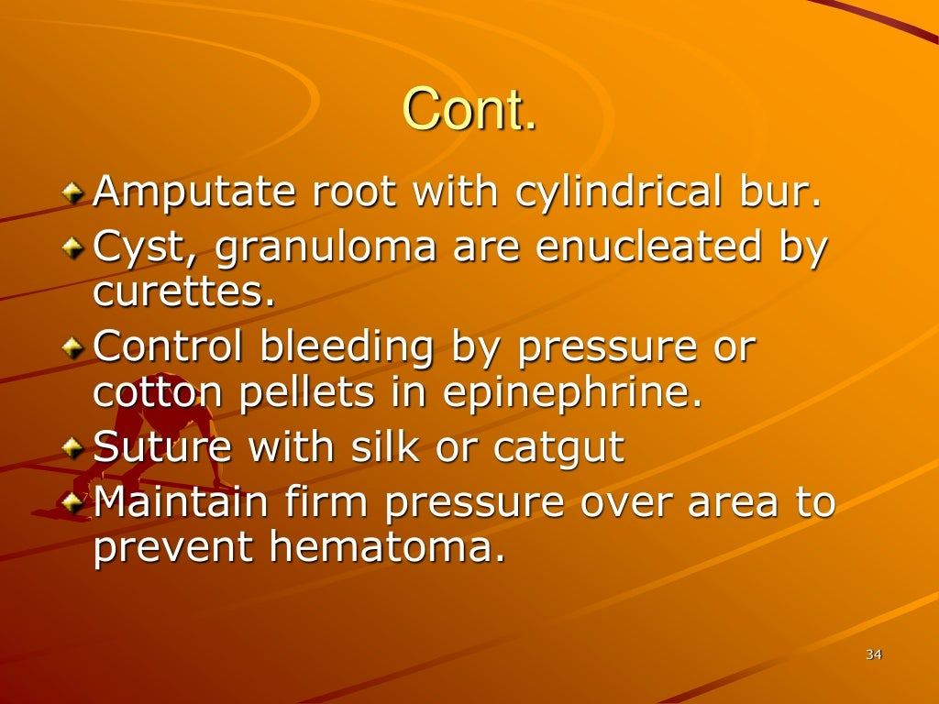

Slide 36
TAKE HOME MESSEGE
The ideal tooth extraction is a painless procedure in which removal of whole tooth, or root with minimum trauma to soft and hard tissue so that bone heals uneventfully with no postoperative problems.
Indication for extraction are teeth affected by pulpal lesion, periodontal disease, impacted and supernumerary teeth involved in tumors or cyst.
Operative complication during extraction of teeth are fracture of the tooth or bone, root displacement, sinus perforation, tmj, trauma, cheek biting.

